Slide 1

Perplexity Interface
Making work easier
Antonio Lopez
Enterprise AI Deployment · IBM

Slide 2
THE PATTERN
PERPLEXITY INTERFACE
Categories open when one product makes a new capability usable in a single sitting.
1979
Now
Dan Bricklin
AI Companies
Hours to seconds breakthrough
Lagging productivity gains
CATEGORY DEFINED
CATEGORY OPEN
Antonio Lopez · Enterprise AI Deployment · IBM
2 / 7

Slide 3
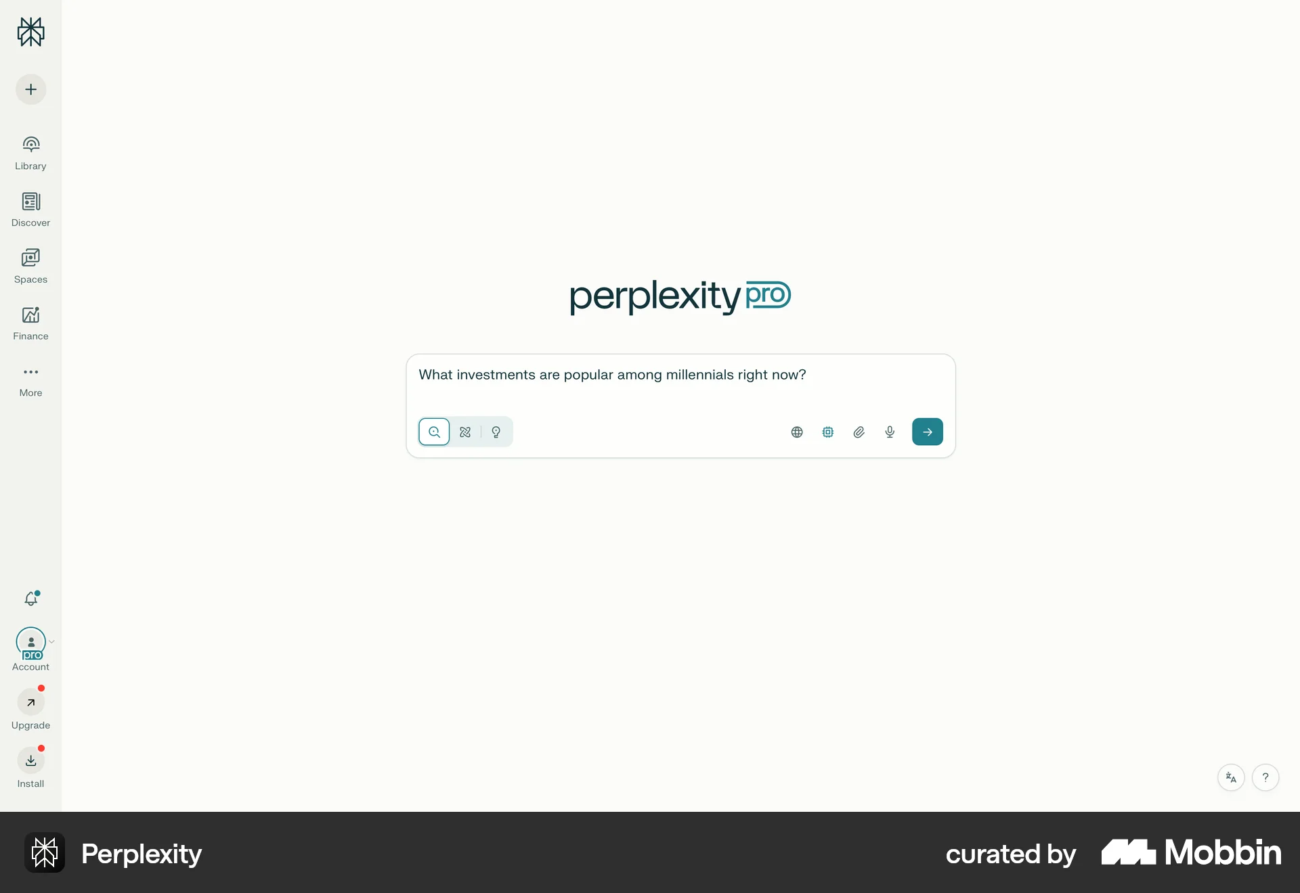
Pro
(before)

Slide 4

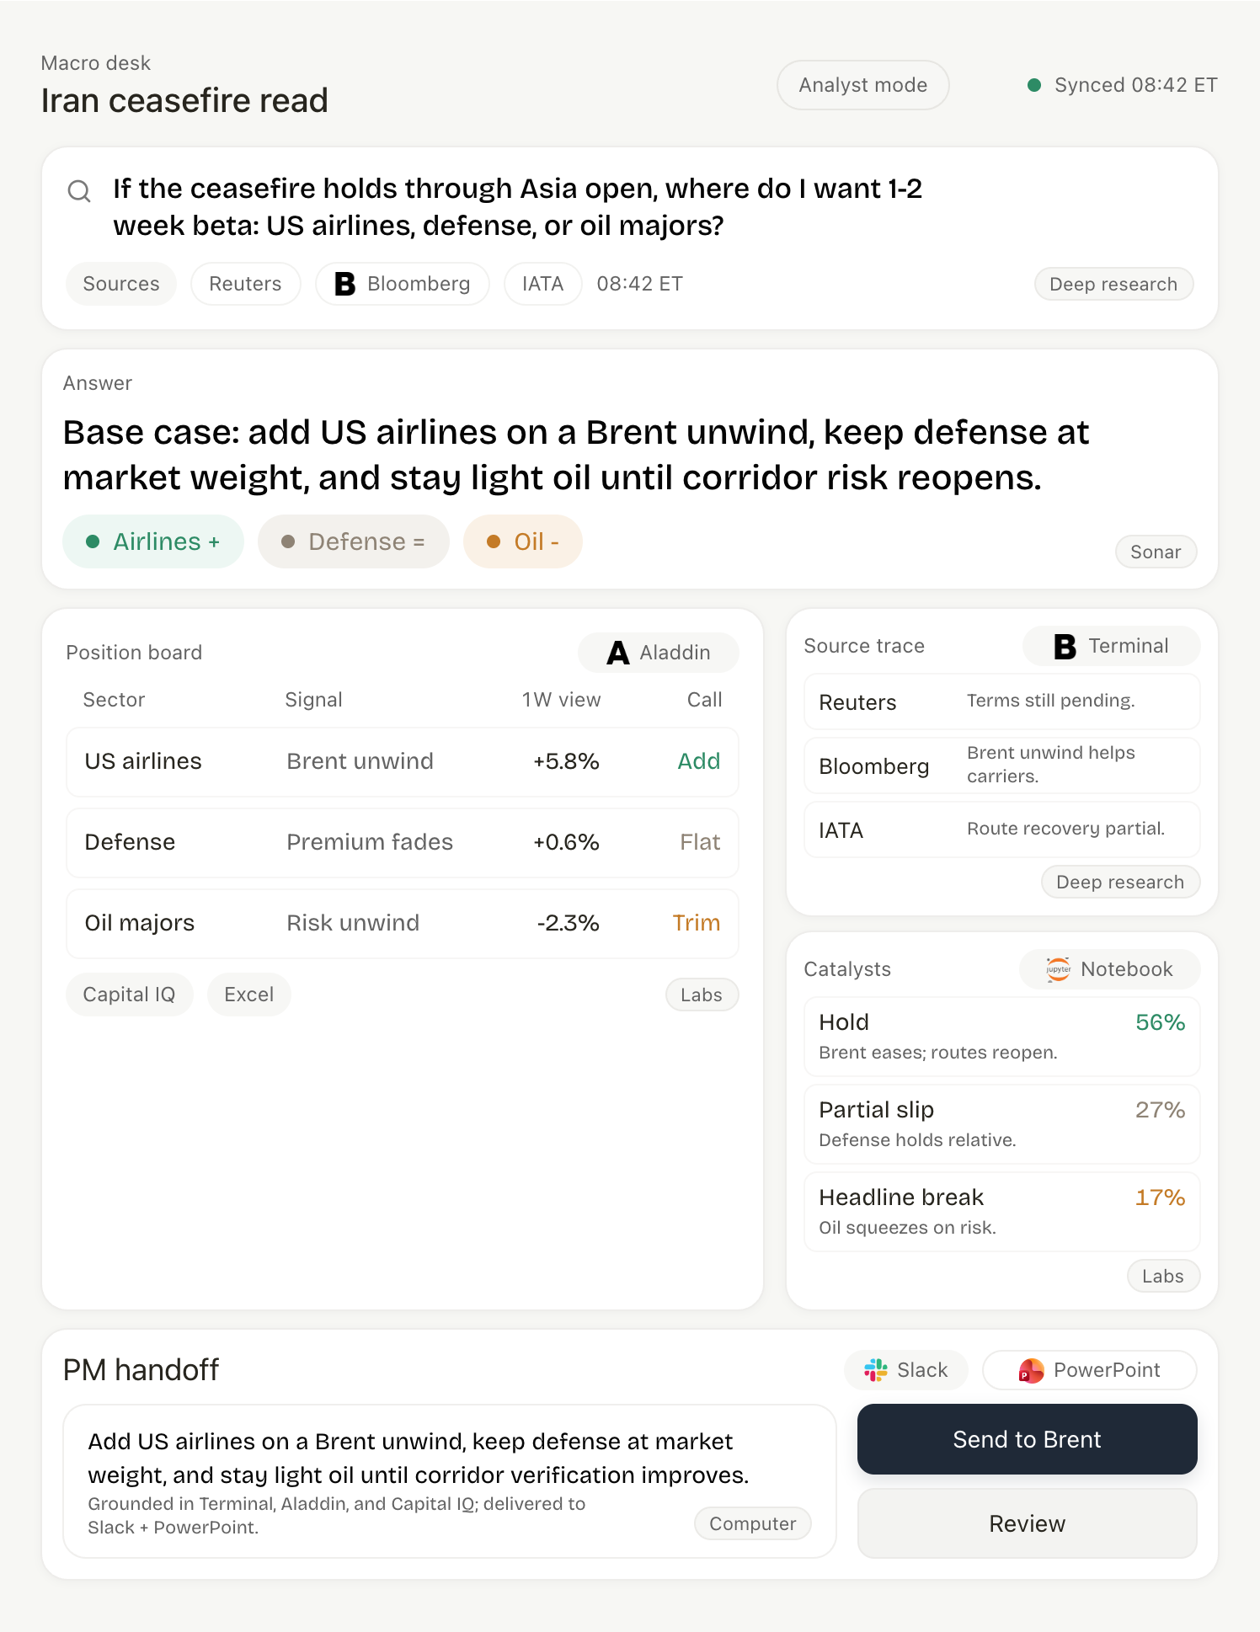
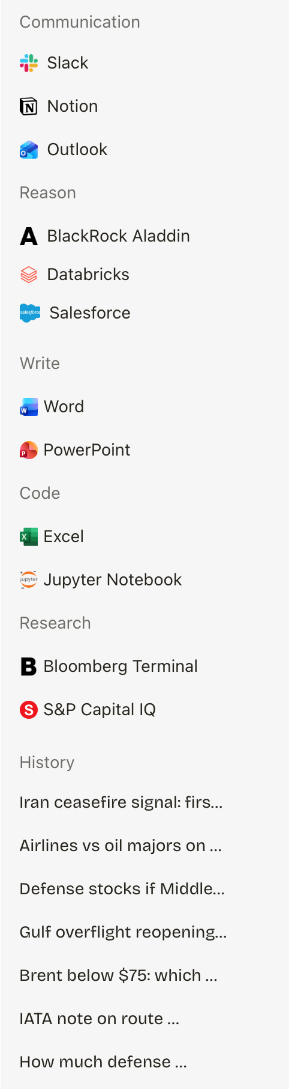
Interface
(after)

Slide 5
PERPLEXITY INTERFACE
Agenda
Three points for why Perplexity Interface should exist now.
01
The Fragmentation Tax
Why context switching blocks the productivity gains companies expected from AI.
02
The Existing Stack
How Deep Research, Sonar, Labs, and Computer already contain the pieces needed.
03
Timing & Prototype
Why the category will form quickly, and what to test in a 45-day pilot.
Antonio Lopez · Enterprise AI Deployment · IBM

Slide 6
WHAT AI CAN DO NOW
PERPLEXITY INTERFACE
No environment runs all four in sequence.
01
02
03
04
Research
Reason
Code
Write
Synthesizing global reports
Contextualizing business cases
Grounding ideas in sources & structure
Deciphering truths in messy data lakes
Creating tangible outputs
Accelerating processes 10x
Crafting prose of discoveries
Drafting documentation
Who Cares?
Context switching (Fragmentation Tax) costs the economy an estimated $450 billion annually
The Effects of Multitasking on Organizations. Published via PR Newswire
Antonio Lopez · Enterprise AI Deployment · IBM
3 / 7

Slide 7
POINT 1 — THE FRAGMENTATION TAX
PERPLEXITY INTERFACE
The Fragmentation Tax
ENTERPRISE ADOPTION
MEANINGFUL GAINS
89%
40%
of enterprise buyers report using AI tools regularly.
of the same cohort report measurable productivity lift.
The 49-point gap
is an opportunity to capture value for users
Source: McKinsey enterprise buyer survey, Q1 2025; cross-validated with Goldman Sachs analysis showing AI spend alone did not correlate with productivity, while unified environments showed ~30% gains.
Antonio Lopez · Enterprise AI Deployment · IBM
4 / 7

Slide 8
GOLDMAN SACHS — PRODUCTIVITY SIGNAL
PERPLEXITY INTERFACE
Productivity follows workflow design
The lift appears where work happens inside one unified environment.
UNIFIED ENVIRONMENT
ONE WORKSPACE
+30%
PRODUCTIVITY
Antonio Lopez · Enterprise AI Deployment · IBM
Source: Goldman Sachs cross-economy earnings analysis 2025

Slide 9
POINT 2 — THE EXISTING STACK
PERPLEXITY INTERFACE
Perplexity existing IP is sufficient for Interface
DEEP RESEARCH
SONAR API
Research layer
Retrieval layer
Broad synthesis across large source sets
Real-time grounded retrieval from cloud & on-prem
LABS
COMPUTER
Reasoning engine
Action layer
Code execution and structured analysis
Agent (labor) in the browser
INTERFACE
Integrated Deployment
One surface for all kinds of work
Antonio Lopez · Enterprise AI Deployment · IBM
5 / 7

Slide 10
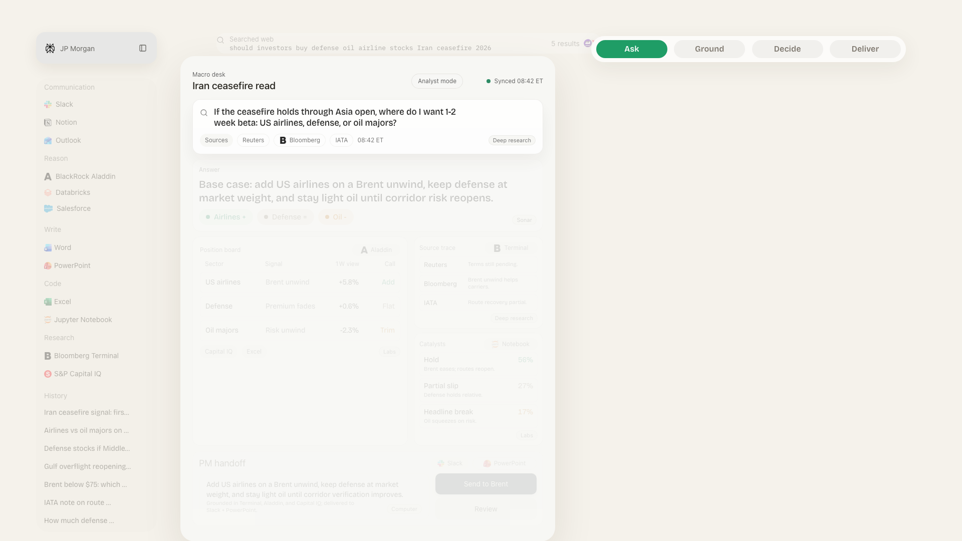
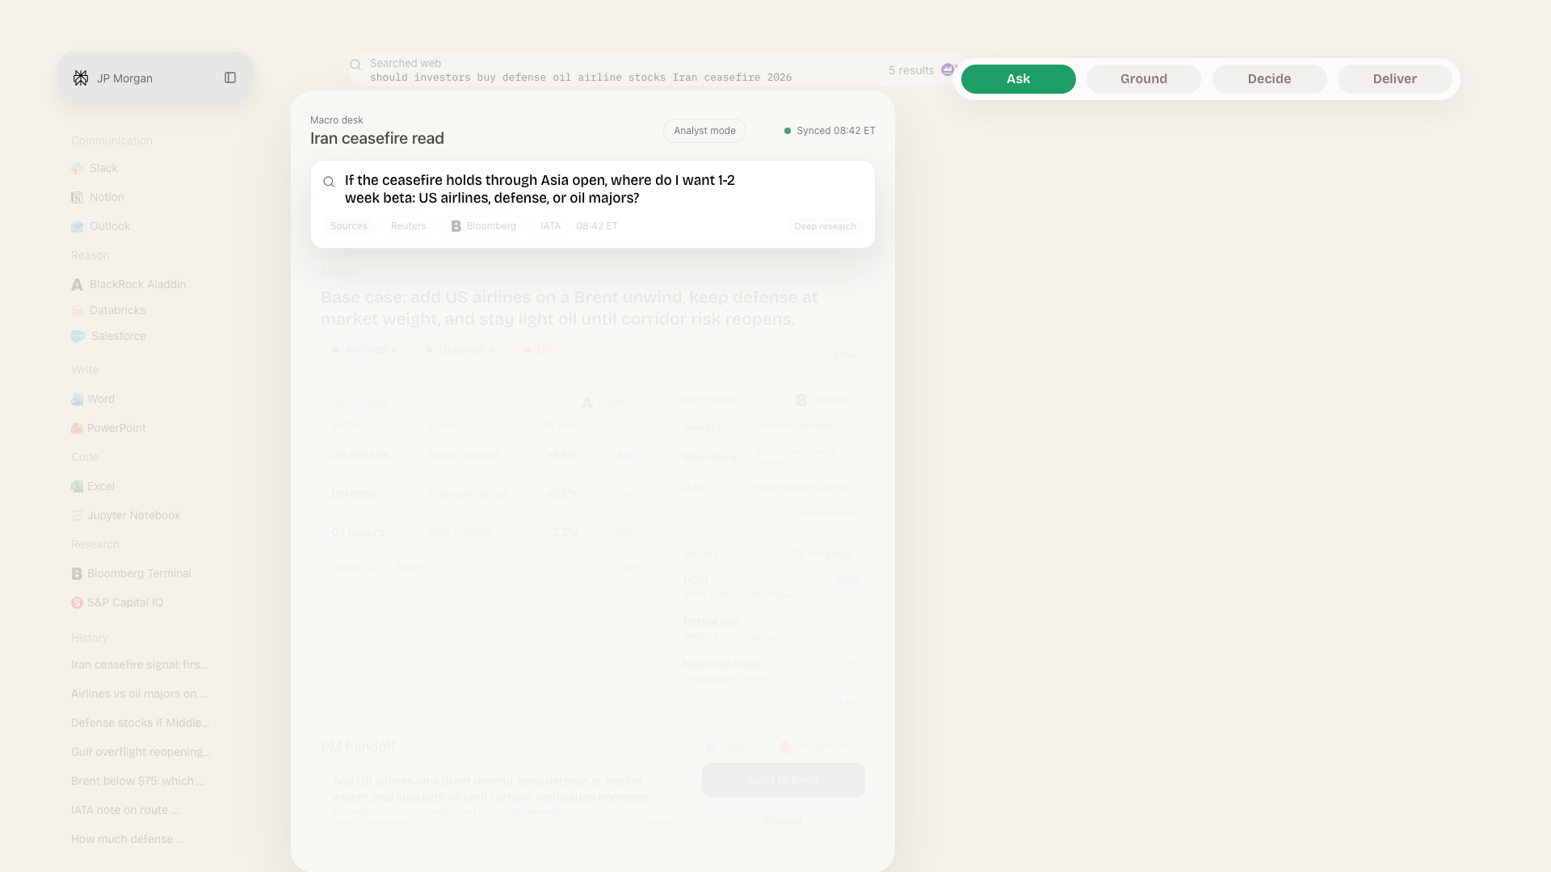
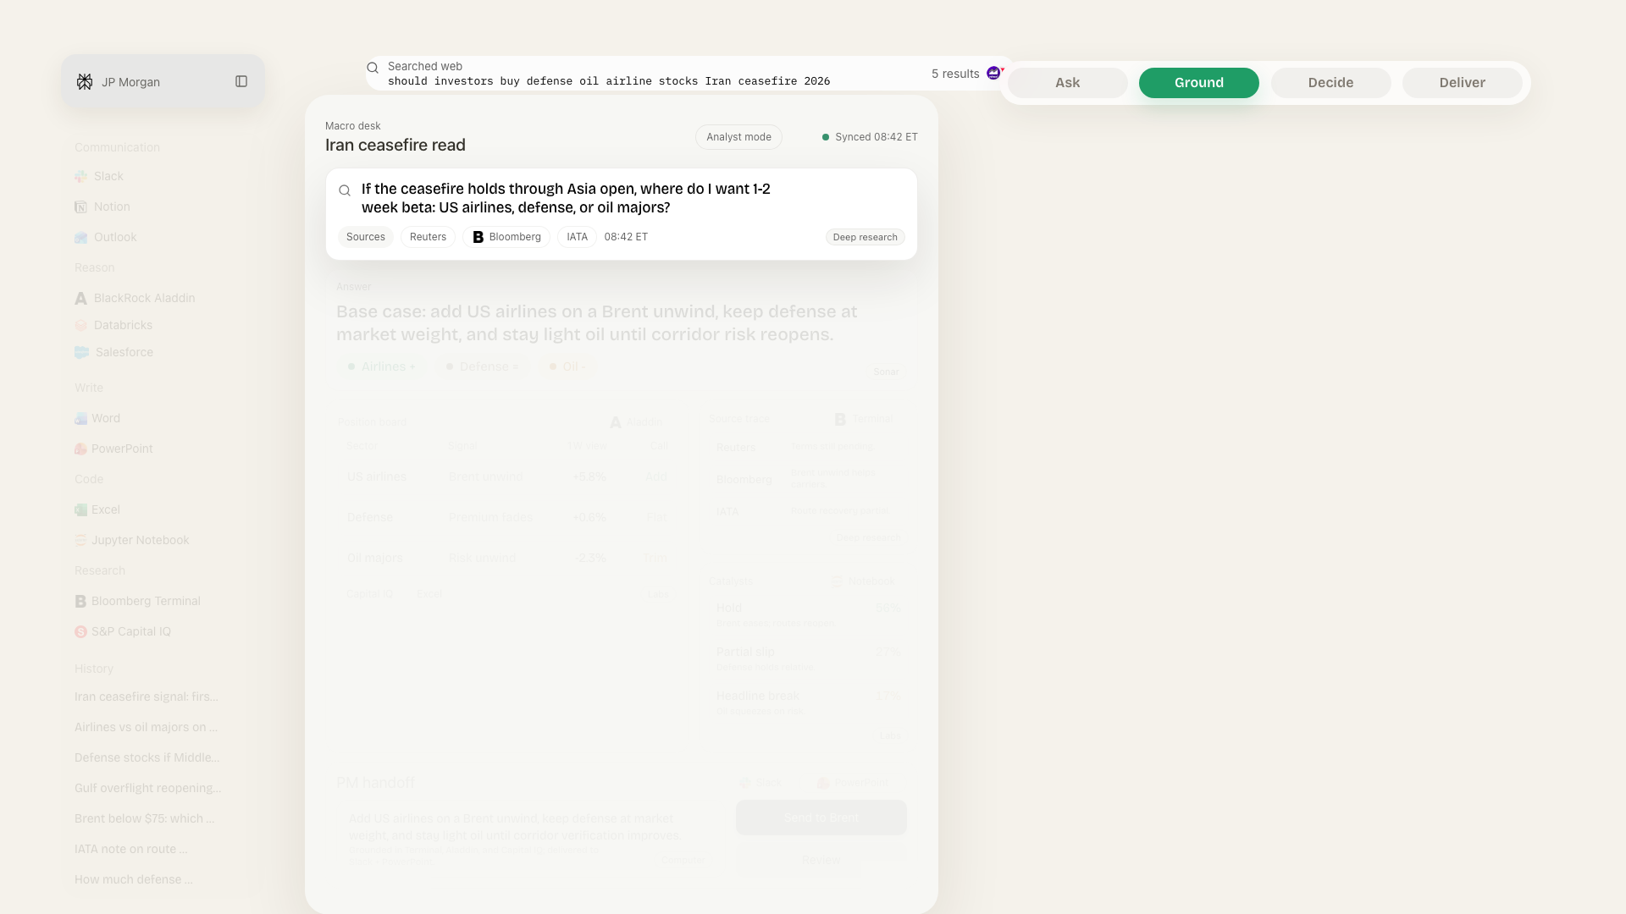
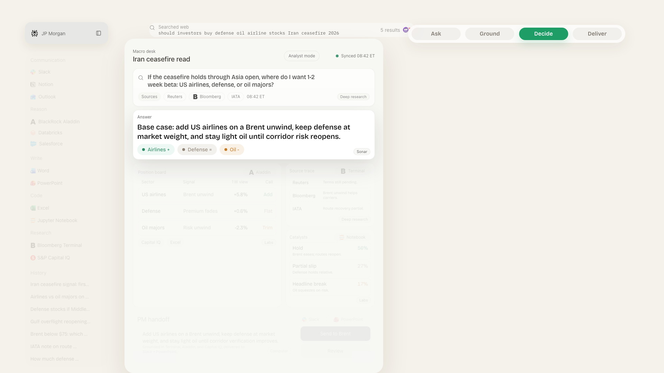
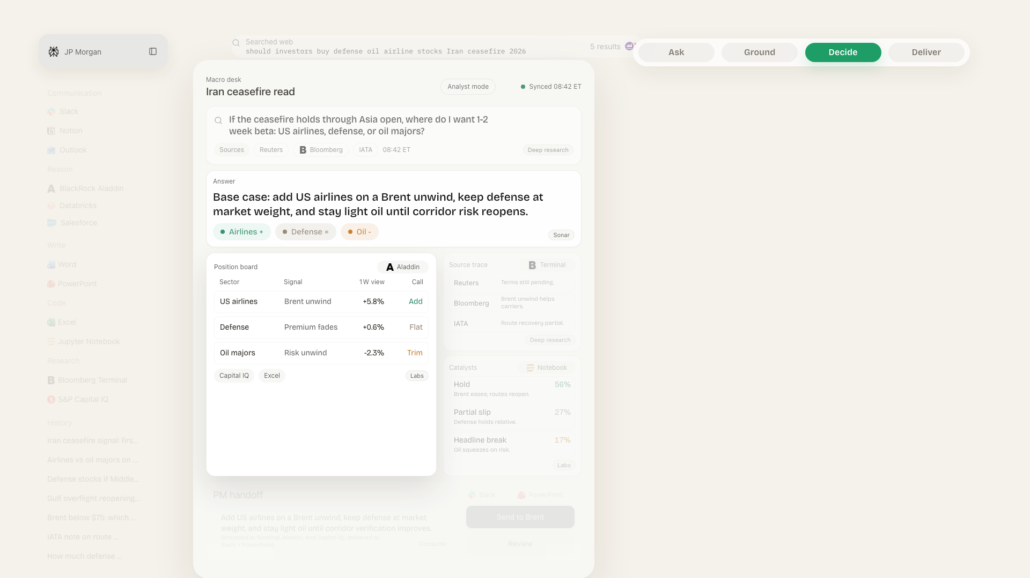
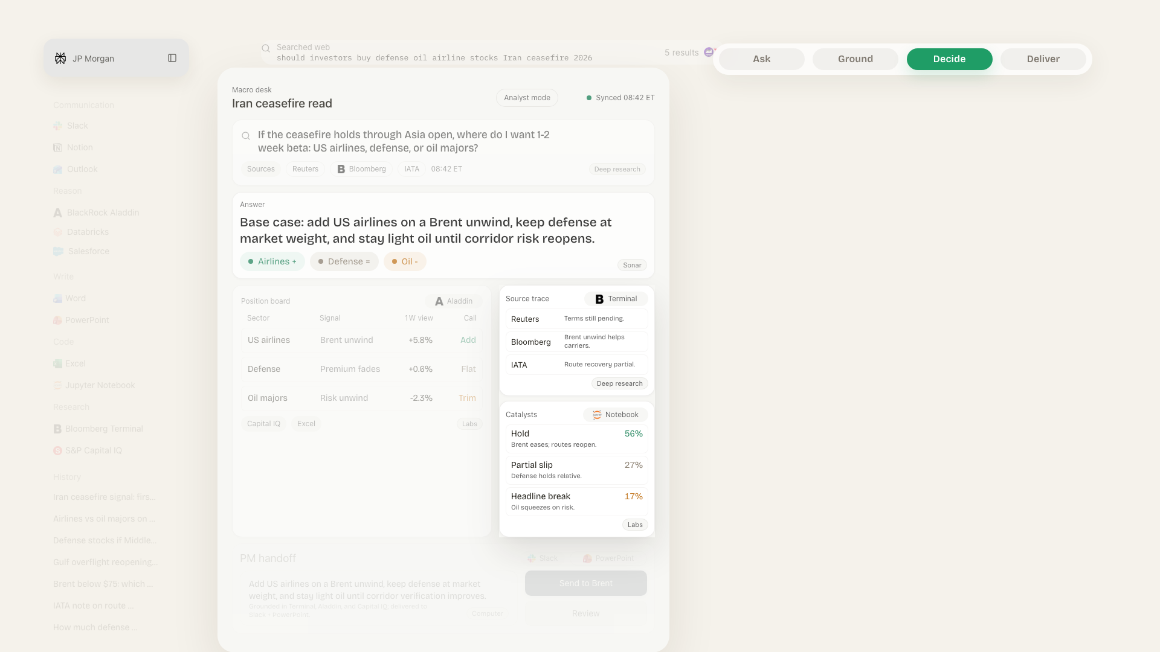
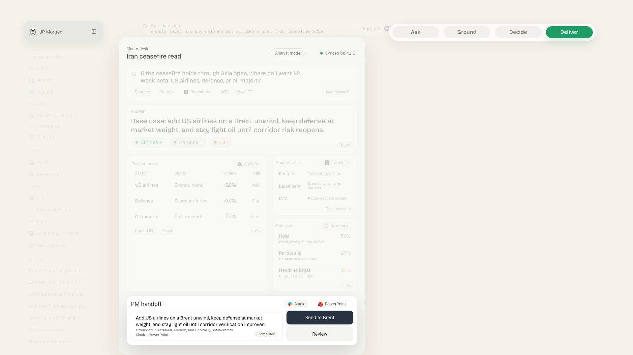
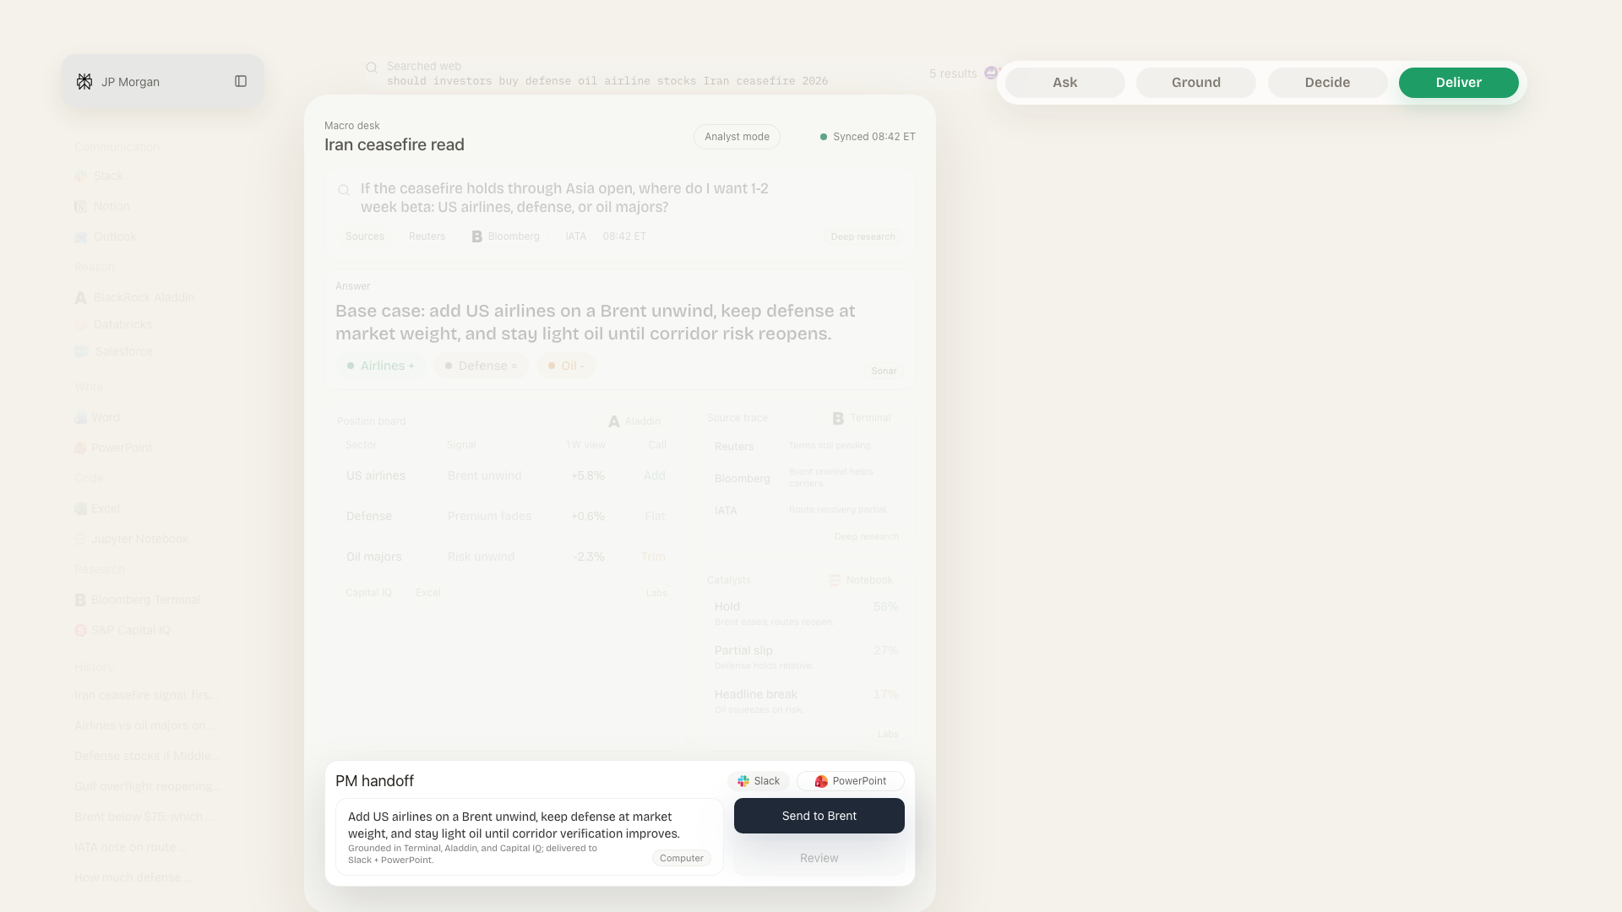
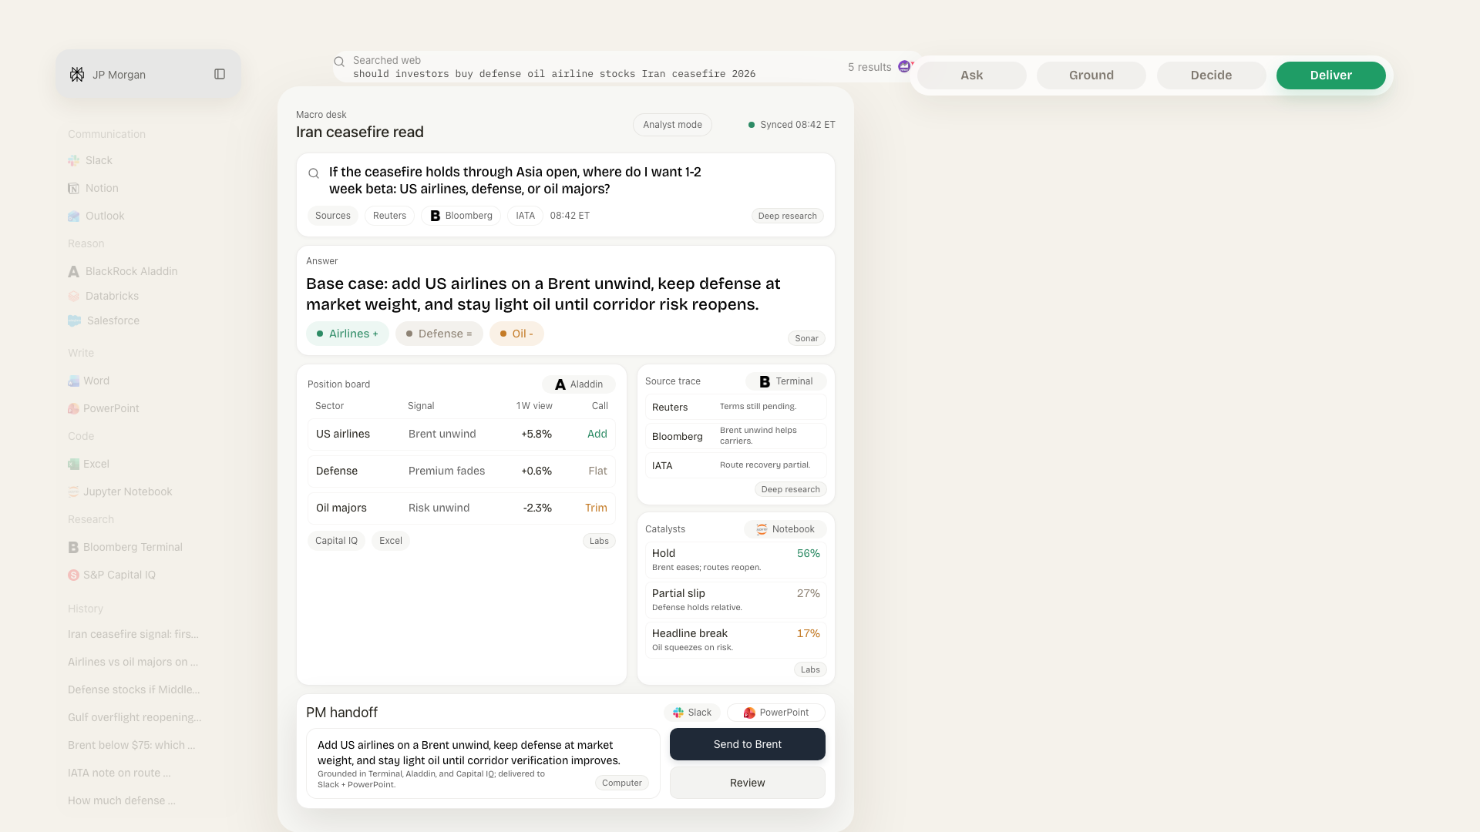

Slide 11
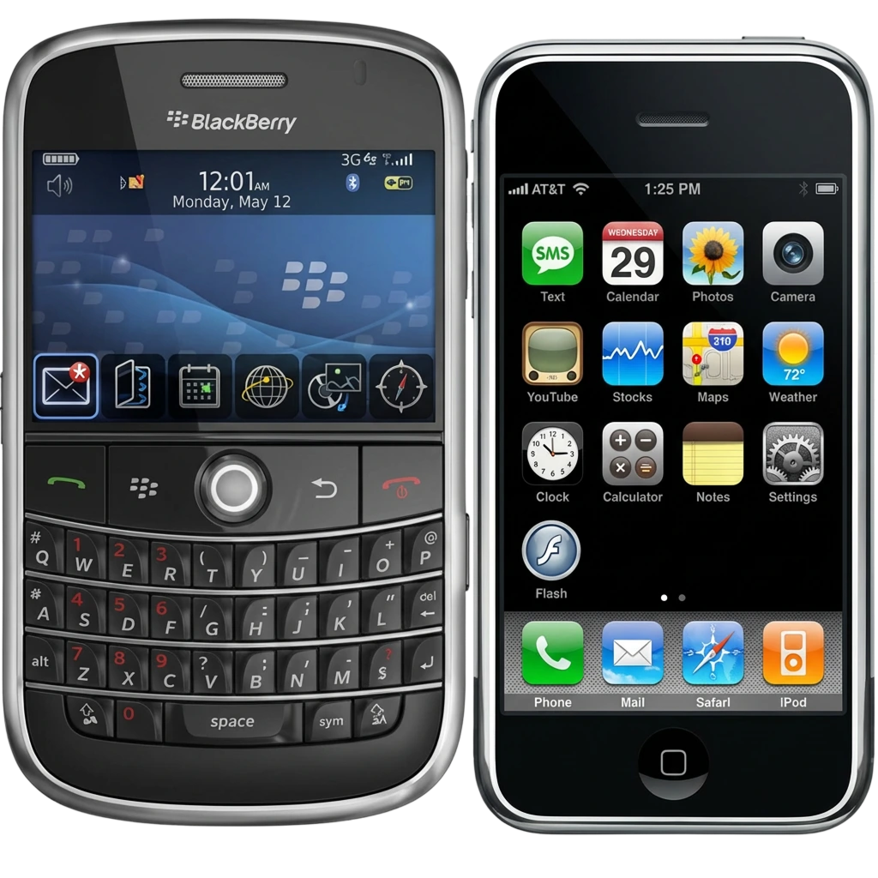





POINT 3 — THE WINDOW
PERPLEXITY INTERFACE
Categories get defined once while the rest imitate (or get left behind)
First movers anchor the market – Apple in Hardware, Slack in Communication Software, Salesforce in CRM Software
NOW — Q2 2026
Q3 – Q4 2026
Q1 2027
Window open
Competitors moving
Category closes
Antonio Lopez · Enterprise AI Deployment · IBM
6 / 7

Slide 12
WHAT THIS PROPOSAL ADDS
PERPLEXITY INTERFACE
~ Three-month sprint
01
45-DAY PROTOTYPE
Connect Deep Research & Sonar to realtime DBs
Labs & Computer handle generative execution
All visible in a single window
Working end-to-end workspace.
02
200 – 500 POWER USERS
Recruit existing high-frequency enterprise users to pilot
Highest signal for retention and workflow adoption
First controlled test.
03
TWO MEASUREMENT QUESTIONS
Do users come back?
Do they begin doing more of their work inside the product?
How do we quantify or meter its worth?
The signals that decide it.
Antonio Lopez · Enterprise AI Deployment · IBM
7 / 7

Slide 13
Interface
Making work easier
Thank you!
Antonio Lopez
Enterprise AI Deployment · IBM

